Slide 1
Program i dag
Eksamensopgave – rapport!
Eksamensemner – mundtlig eksamen.
Teori: Comparison of methods
PAB 2018

Slide 2
Eksempel på Eksamensspørgsmål
Beskriv de relevante faktorer at have med når man skal vælge en systemudviklingsmetode
Generelt
I relation til dit projekt
XP og Scrum – forklar
Hvordan continuous Integration og testing forstærker hinanden
Hvordan parprogrammering og Collective Ownership forstærker hinanden
Hvorfor XP og Scrum kaldes for adaptive
Hvor XP og Scrum har ligheder og forskelle
Forklar kort de følgende koncepter
Vandfaldsmodel
Black box testing
Inductive reasoning
Exploratory Prototyping

Slide 3
Agenda
Goal
Be able to compare and discus different systems development processes
Be able to classify Scrum and XP

Slide 4

Systems development
Visions and requirements
Systems
Development
process
To succeed we need a systematic approach concerning
The structure of the product
The process producing the product

Slide 5
How to choose an approach?
Situation
Define the Task at hand
Choose a process model which suits the task
Choose a method within the process model
Use the recommended techniques and tools
Process models
System development methods
Techniques
Tools
BUT …never be mechanistic:
Adapt the method
Perhaps combine methods
Be pragmatic
Focus on approaches that works
Remember:
“There is no silver bullet”
Death over standard methods!

Slide 6
Systems development and uncertainty
Systems development is a creative process!
Routine – Problem solving – Problem definition
In systems development many decisions are taken!
Start
Goal

Slide 7
Types of situations
Attributes in Relation to Situation | Assignment or problem | Working practice | Uncertainty
Routine | Known | Known | Small
Problem solving | Known | Unknown | Intermediate
Problem setting | Unknown | Unknown | Large

Slide 8
Systems development and uncertainty
Problem definition situations are characterized by symptoms, it is important to identify the problem / task behind
Problem solution situations are open, often requires an experimenting and searching approach
Routine Situations are 'easy' to handle, but may require extensive and qualified effort
High
uncertainty
 | The task is known | The solution is known
Problem definition | no | no
Problem solving | yes | no
Routine | yes | yes
Low
uncertainty

Slide 9
How to choose an approach?
Situation
Define the Task at hand
Choose a process model which suits the task
Choose a method within the process model
Use the recommended techniques and tools
Process models
System development methods
Techniques
Tools
BUT …never be mechanistic:
Adapt the method
Perhaps combine methods
Be pragmatic
Focus on approaches that works
Remember:
‘There is no silver bullet’
Death over standard methods!

Slide 10
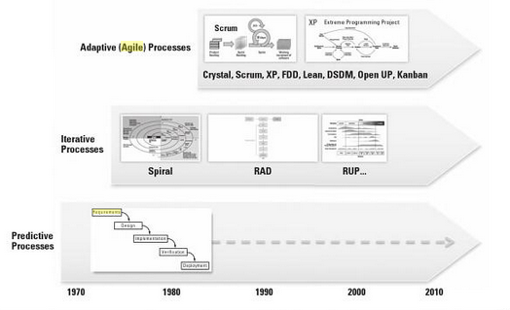
Process models (paradigms)

Slide 11
Methods and systems development theory
Methods have a more or less defined scope
Methods have an underlying perspective
Methods provides guidelines for how the process should proceed:
The sequence in which to carry out the functions
The artefacts to produce
Experience is essential for system developers
Methods are experience put in patterns
Methods are not practical if the situation does not fit
General knowledge – systems development theory
Method Independent understanding of systems development

Slide 12
Ideal and reality
Many methods build on a rational ideal:
Common and clearly defined goals
Adequate and accessible resources
Developers can analyse their way to relevant designs and predict their consequences
System developments projects in real life:
Starts without clearly defined goals
Design decisions are taken without analysis of alternatives
Great complexity
Changing requirements
…

Slide 13
What’s a process model and a method?
Process models are differentiated by their sequence of activities
For instance, first full analysis, then design …
Methods are differentiated by the content of the activities
For instance:
Which activities are carried out during design?
Which artefacts are made during analysis?

Slide 14
Waterfall, predictive, plan driven - “The devil” is known by many names ☺
Known goals/tasks
Maintenance
Large systems
Division of work
Requirements
Design
Implementation
Verification
Deployment

Slide 15
Waterfall, predictive, plan driven
The process model presupposes requirements can be specified ”up front”
Cost and time can thus be estimated based on the requirements
Fixed price contract
But what about quality?
Better than ”code ‘n’ fix”
Immediately logical and predictable
Most software is developed like this
Fixed price contract is a must
Requirements
Plan
Driven
Cost
Time

Slide 16
Problems with the waterfall model
31 % of projects were cancelled before completion
53 % of the projects will cost more than 189% of their estimates
Only 16 % of projects are completed on time and budget
Completed projects delivered only 42% of the original requirements
Ineffective treatment of requirements is the primary cause of cancelled projects:
13% of projects lack user input
12% of projects have incomplete requirement specifications
12% of projects have changing requirement specifications

Slide 17
Iterative and incremental processes
Advanced development tools and technologies
Increased ‘time-to-market’ pressure
Need for new innovative exploration based methods
Generic model for iterative and incremental methods
Spiral model: Experimental exploration
Methods
RAD (Rapid Application Development): Development of prototypes with advances tools
UP: Iterative and incremental development of big and complex systems

Slide 18
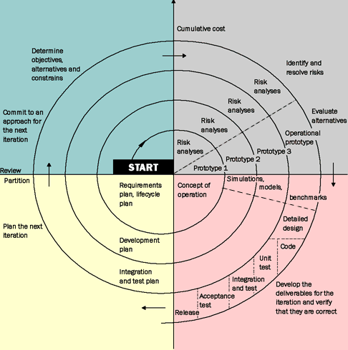
Spiral model - iterative og incremental
Boehm 1988
The first published
iterative og incremental method
Accept of change of requirements
Focus on continuous feedback
Gradually expansion of the system through prototypes

Slide 19
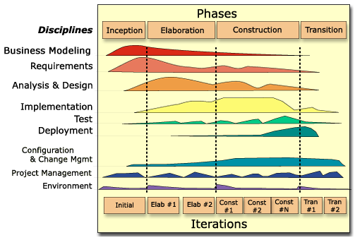
Unified Process

Slide 20
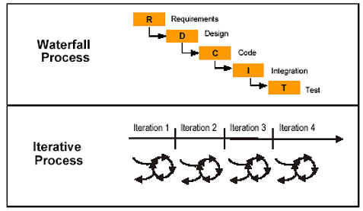
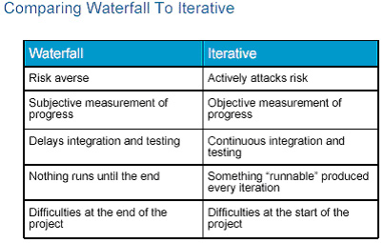
Waterfall vs. Iterative Process
There can be feedback loops between these steps, but the dominant practice is that a particular discipline is mostly completed before moving on to the next discipline.
In an iterative process you accomplish a small amount of each of the disciplines (requirements, analysis, design, implementation, and testing) in every iteration
Kilde: http://www.ibm.com/developerworks

Slide 21
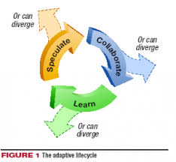
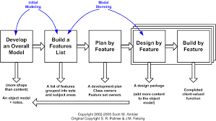
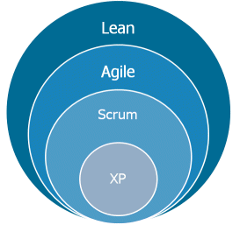
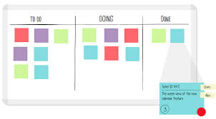
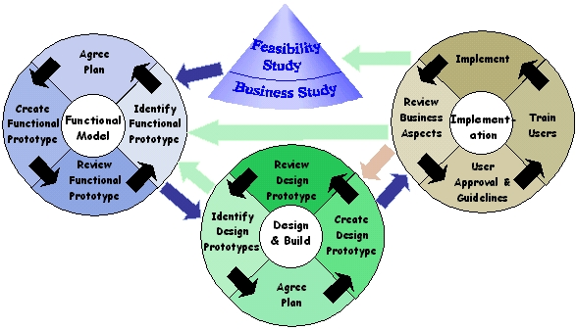
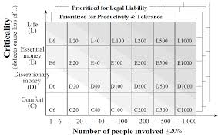
Agile (adaptive) processes

Slide 22
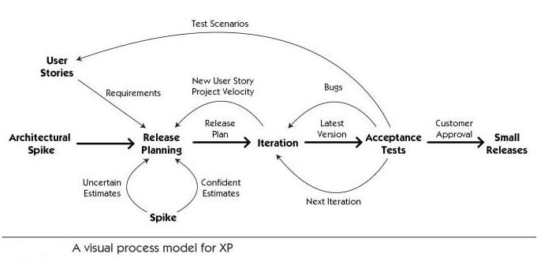
XP - agile

Slide 23
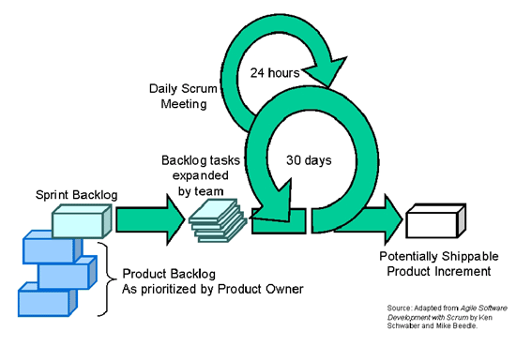
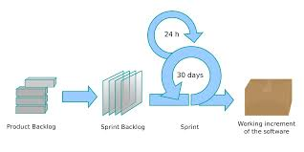
Scrum - Agile

Slide 24
Value driven instead of plan driven
Goodbye to the iron triangle
Waterfall
Agile
Requirements
Resources
Time
Plan
Driven
Determined
Value
Driven
Estimated
Cost
Time
Requirements

Slide 25
Sub functions of systems development
Performance
Management
Analysis
Design
Realisation
Evaluation
Planning
Regulation
General
Decision-making
Communication
Socialisation

Slide 26
Main components of systems development -A methodology independent description
Visions
Present
reality
Visions
Present
reality
Reflec-
tion
Design
Analysis
Planning
Evaluation
Action
Realisation
Regulation
Product-oriented
Process-oriented

